Slide 1


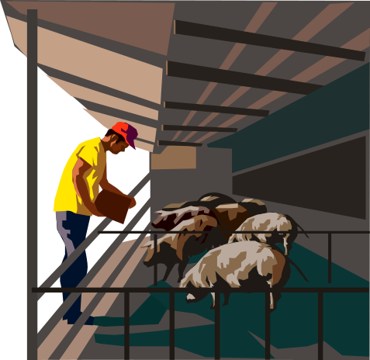
Operations & Employees
AREC 213
Week 8

Slide 2

Operations Essentials
Location & Physical Facilities
Production Processes and Quality
Supply Channels/Vendor Relationships
Record Keeping Systems
Risk Management
Employees

Slide 3

Choosing a Location
What should you consider when choosing your location?
  Type of business it is?
  How will sales be conducted?
  What kind of foot traffic you need?
  How far customers will be willing to travel?
  Parking or shipping access?
  What else?????
Operations

Slide 4














Physical Facilities
Besides spaces for plants or animals what other space/facility needs will you have?
Processing/
Production
Hospitality/
Customer Events
Shipping/
Receiving
Equipment
Storage/Repair
Merchandise
Display/Retail
Sales
Supplies/Finished
Goods Storage
Office Space

Slide 5


Production Processes
All production processes should be written down! Why?
Ensure quality and consistency
Control materials
Protect equipment
Hire and train employees
Back customer guarantees
So YOU can take a vacation
without things falling apart!
Notes:
When I say “production processes” what am I talking about?
I’m talking about HOW you do what you do. How you raise your crops or animals. How you process your produce or animals for sale. How you conduct nutritional analysis. How you weigh, package, store and track your inventory. How you manage your distribution. How you transact sales. How you store, maintain and repair your equipment. How you keep your records.

Slide 6

What is “Quality”?
It’s your PROMISE to your Customer
Consistency
Accessibility
Reliability
Predictability
Integrity

Slide 7

How do you Ensure Quality?
DOCUMENT processes
SET CRITERIA for what a “good one” looks like
TRAIN well
SOURCE from trusted suppliers
CHECK regularly
INSPECT periodically
ASK customers for feedback

Slide 8


Vendors and Supply Channels
Sources of Goods
Supplier Alternatives
Critical Dependencies
Vendors are Relationships

Slide 9

Recordkeeping
Keep records from DAY 1 of your business
Set up systems to record:
  Cash/Credit Receipts
  Invoices
  Checks
  Deposits
  Contracts and Agreements
  Vendor info
  Customer info
Recruiting & Hiring

Slide 10

Risk Management
Worry sucks the joy out of having your own business. Manage it by:
Writing down each thing that could go wrong and decide:
  How likely it is to happen 1-10
  How bad it would be if it did happen 1-10
  How you can avoid it
  How you can lessen the impact if it does happen

Slide 11

Employees
Employees represent one of the largest costs a small business owner has
  Direct (salary, benefits, training, turnover)
  Indirect (morale, customer service)
  Opportunity Cost
30% of all businesses fail due to poor hiring or employee management practices

Slide 12
How do you Get and Keep Good Employees?
Know what a “good one” looks like
Use good recruiting, screening, interviewing practices
Train well and often
Keep communication channels open
Give useful and regular feedback
Compensate fairly for your industry
Use incentives to reinforce behaviors you want

Slide 13

Know What a “Good One” Is
Write a job description including:
Technical Skills
Transferable Skills
Product, process, or service knowledge
Educational Background
Certificates
Experience/Job History
Self Starter
Communications Skills
Positive Attitude
Personality “Fit”
Good Teamwork
Problem Solver
Honesty, Integrity

Slide 14

Finding Qualified Applicants
Personal Contacts
Internet/Newspaper
Advertising
Vendors
Competitors
Trade Shows
Temp Agencies
Job Fairs or Job Placement Programs

Slide 15
Screening Applicants
Technical Skills
Transferable Skills
Self Starters
Communications Skills
Positive Attitude
Personality “Fit”
Teamwork
Problem Solver
Honesty, Integrity
Product, process, or service knowledge
Educational Background
Certificates
Experience/Job History
Resume
Reference Checks/
Interview

Slide 16

Reference Checks
Match technical skills to job description
Verify history
Check references
Create short list of candidates for interview
Develop interview scorecard
80% of Applications contain false work history
30% contain false education history

Slide 17

Interviewing Candidates
Ask where they heard about your job and why they want to work with you.
Give an overview of your business and the context for the job.
Discuss the duties/responsibilities.
Explore individual’s qualifications, abilities, experience, motivation, and interests.
Ask what in applicant’s experience makes them able to do the job.
Ask what challenges they’ve had in previous jobs and what specifically they did to address them.
LISTEN CAREFULLY TAKE GOOD NOTES

Slide 18
Employment Paperwork
Employee Policy Manuals
  Set Expectations
  Performance Standards
  Not a Contract
Special Agreements
  Non-Disclosure Agreement
  Intellectual Property Agreement
  Non-Compete Agreement
Recruiting & Hiring
Notes:
OSHA has promulgated thousands of standards. Some apply to all businesses while others relate to a specific process or a specific machine. Most are very sensible guidelines for improving safety of the workplace.
Others are controversial because the high cost they impose of industry.
Requires that most employers keep records of work related injuries, illnesses, and deaths.
Employees may complain to state OSHA office about unsafe or unhealthy conditions and OSHA obligated to inspect if there is reasonable grounds that a danger is present.
OSHA may inspect workplaces and may impose fines. Generally fines are monetary, but can include imprisonment.
ANSI – excellent resource for basis of work procedures.

